Slide 1
Lecture 14 Working with Key/Value Pairs
ITP4869 Analysis with Programming Tools
(AY 2018/19)
Dr. Johnny Cheng

Slide 2
Lessons Intended Learning Outcomes
On completion of this lesson, students are expected to be able to:
Explain the rationale behind using key/value pairs;
Create pair RDDs;
Write code using transformations and actions on pair RDDs; and
Perform data aggregation on pairs RDDs.

Slide 3

Overview of Key/Value Pairs

Slide 4
Overview of Key/Value Pairs
Key/Value Pairs are common data type required for many operations in Spark.
Key/value RDDs are commonly used to perform aggregations.
We may often do some initial ETL (extract, transform, and load) to get our data into a key/value format.
Key/value RDDs expose new operations, such as
Counting up reviews for each product;
Grouping together data with the same key; and
Grouping together two different RDDs.

Slide 5
Overview of Key/Value Pairs (cont.)
Spark provides special operations on RDDs containing key/value pairs.
These RDDs are called pair RDDs.
Pair RDDs are a useful building block in many programs, as they expose operations that allow you to act on each key in parallel or regroup data across the network.
It is common to extract fields from an RDD and use those fields as keys in pair RDD operations.

Slide 6
Creating Pair RDDs

Slide 7
Creating Pair RDDs
There are a number of ways to get pair RDDs in Spark.
We may have a regular RDD that we want to turn into a pair RDD.
We can do this by running a map function that returns key/value pairs.
Suppose we starts with an RDD of lines of text and keys the data by the first word in each line.
In Python, for the functions on keyed data to work we need to return an RDD composed of tuples.

Slide 8
Creating Pair RDDs (cont.)
>>> lines = sc.textFile('spark.txt')
>>> pairs = lines.map(lambda x: (x.split(' ')[0], x))
>>> pairs.collect()
[('Spark', 'Spark provides a useful data structure called RDD.'),
('RDD', 'RDD stands for Resilient Distributed Dataset.'),
('Transformations', 'Transformations are major operations in Spark.'),
('Persistence', 'Persistence allows future actions to be much faster.'),
('Accumulators', 'Accumulators can be efficiently supported in parallel')]

Slide 9
Creating Pair RDDs (cont.)
When creating a pair RDD from an in-memory collection in Python, we only need to call SparkContext.parallelize() on a collection of pairs.
>>> rdd = sc.parallelize([(1,2),(3,4),(5,6)])
>>> rdd.collect()
[(1,2),(3,4),(5,6)]

Slide 10
Transformations on Pair RDDs

Slide 11
Transformations on Pair RDDs
Pair RDDs are allowed to use all the transformations available to standard RDDs.
Since pair RDDs contain tuples, we need to pass functions that operate on tuples rather than on individual elements.
Let’s look at some transformations on one pair RDD.
Suppose we are given the following pair RDD:
>>> from random import randrange, randint
>>> languages = ['python', 'r', 'scala', 'java', 'php']
>>> langList = [languages[randrange(0,len(languages))] for n in range(20)]
>>> values = [randint(1,10) for n in range(20)]
>>> rdd = sc.parallelize([(k,v) for k,v in zip(langList, values)])

Slide 12
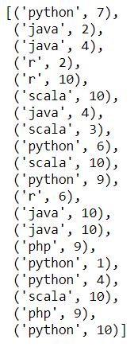
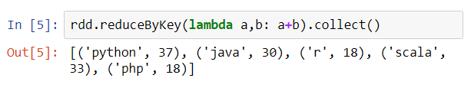
Transformations on Pair RDDs (cont.)
reduceByKey(func) – Combine values on a dataset (K, V) with the same key.
For example,
Reduce by summing the values with the same key
Content of RDD

Slide 13
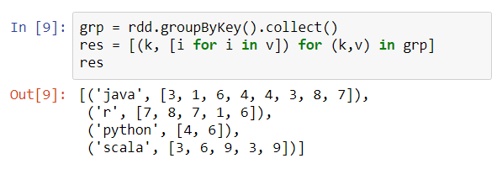
Transformations on Pair RDDs (cont.)
groupByKey() – Combine values with the same key.
For example,

Slide 14
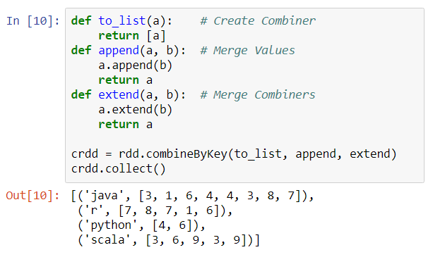
Transformations on Pair RDDs (cont.)
combineByKey(...) – Combine values with the same key using a different result type.
For example,

Slide 15
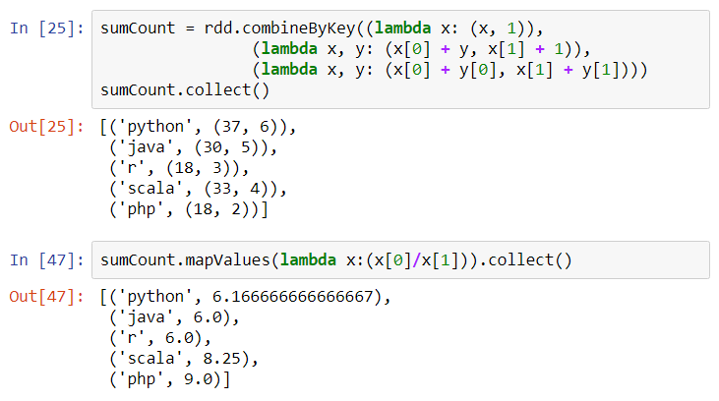
Transformations on Pair RDDs (cont.)
Another example of combineByKey(),

Slide 16
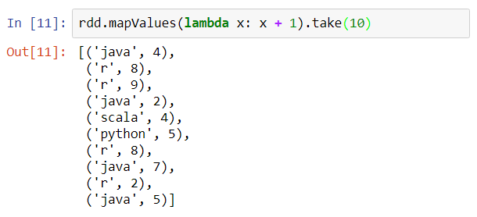
Transformations on Pair RDDs (cont.)
mapValues(func) – Apply a function to each value of a pair RDD without changing the key.
For example,

Slide 17
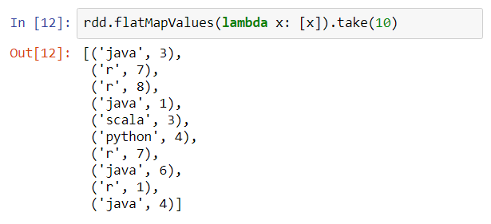
Transformations on Pair RDDs (cont.)
flatMapValues(func) – Apply a function that returns an iterator to each value of a pair RDD, and for each element returned, produce a key/value entry with the old key.
For example,
Return an iterator

Slide 18
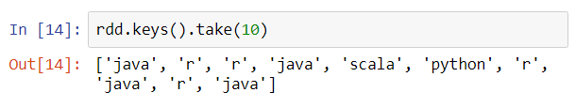
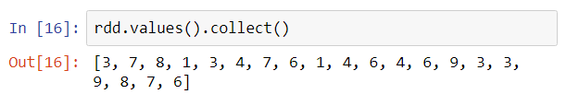
Transformations on Pair RDDs (cont.)
keys() – Return an RDD of just the keys.
For example,
values() – Return an RDD of just the values.
For example,

Slide 19
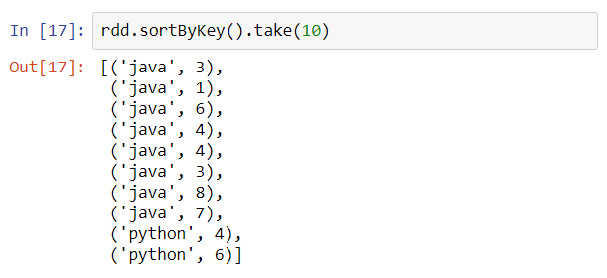
Transformations on Pair RDDs (cont.)
sortByKey() – Return an RDD sorted by the key.
For example,

Slide 20
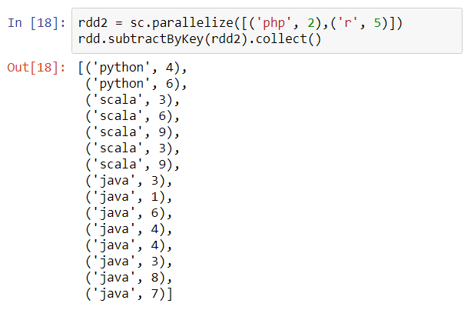
Transformations on Pair RDDs (cont.)
Here are some transformations on two pairs RDDs.
subtractByKey() – Remove elements with a key present in the other RDD.
For example,

Slide 21
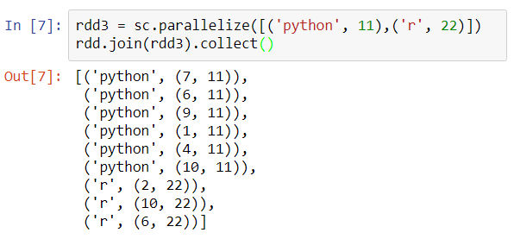
Transformations on Pair RDDs (cont.)
join() – Perform an inner join between two RDDs.
For example,

Slide 22
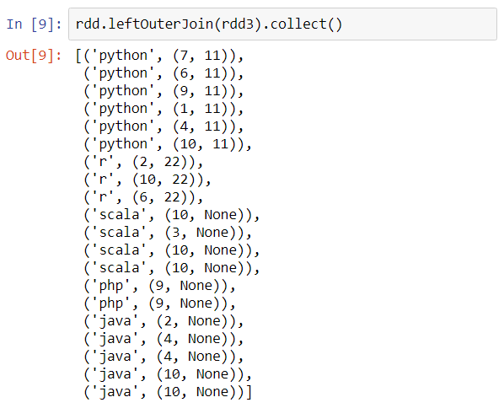
Transformations on Pair RDDs (cont.)
leftOuterJoin() – Perform a join between two RDDs where the key must be present in the first RDD.
For example,

Slide 23
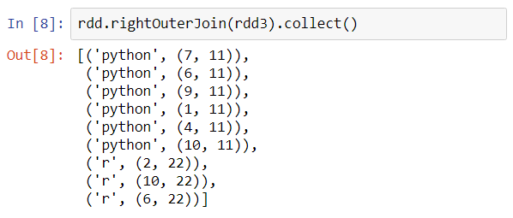
Transformations on Pair RDDs (cont.)
rightOuterJoin() – Perform a join between two RDDs where the key must be present in the other RDD.
For example,

Slide 24
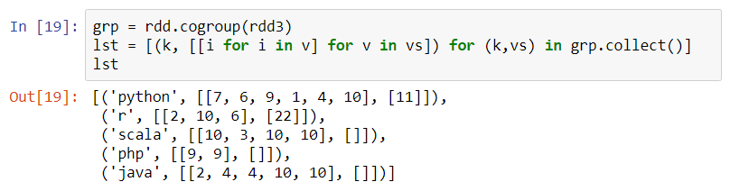
Transformations on Pair RDDs (cont.)
cogroup() – Group data from both RDDs sharing the same key.
For example,
List of tuples (key, value), where value is a list of two lists of numbers

Slide 25
Actions on Pair RDDs

Slide 26
Actions on Pair RDDs
As with the transformations, all of the traditional actions available on the base RDD are also available on pair RDDs.
Some additional actions are available on pair RDDs to take advantage of the key/value nature of the data.
These are listed as follows:
countByKey()
collectAsMap()
lookup(key)

Slide 27
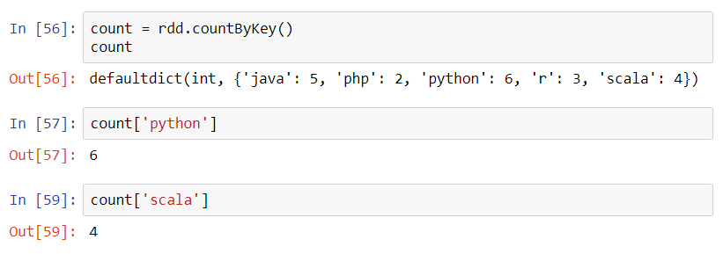
Actions on Pair RDDs (cont.)
countByKey() – Count the number of elements for each key.
For example,

Slide 28
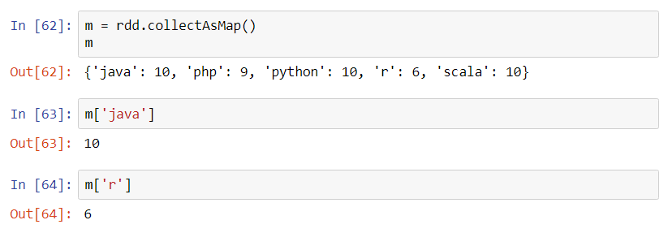
Actions on Pair RDDs (cont.)
collectAsMap() – Collect the result as a map to provide easy lookup.
For example,
Last key/value pair of the same key

Slide 29
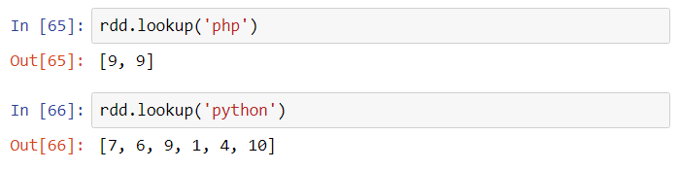
Actions on Pair RDDs (cont.)
lookup(key) – Return all values associated with the provided key.
For example,

Slide 30
Data Aggregation
When datasets are described in terms of key/value pairs, it is common to want to aggregate statistics across all elements with the same key.
Spark has a set of operations that combines values that have the same key.
These operations return RDDs and thus are transformations rather than actions, including
reduceByKey()
combineByKey()

Slide 31

Self Study Guide

Slide 32
Self Study Guide
Reference
Holden Karau, et al. (2015). Learning Spark, O’Reilly.
(Read Ch. 4)
RDD Programming Guide
https://spark.apache.org/docs/latest/rdd-programming-guide.html
PySpark API
http://spark.apache.org/docs/2.4.3/api/python/pyspark.html

